Slide 1
Using optimization to better understand leaf-to-whole plant acclimation
Nick Smith
Texas Tech University
nick.smith@ttu.edu; @nick_greg_smith
Lizz Waring (Northeastern State U)
Helen Scott (TTU)
Trevor Keenan (UC-Berkeley)

Slide 2
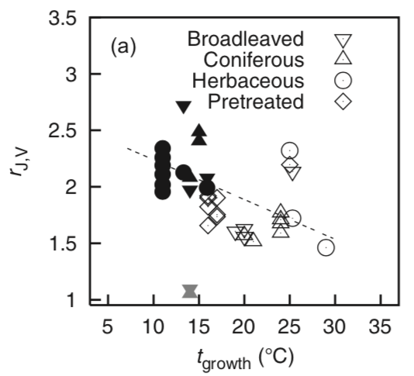
Plants acclimate to changing environmental conditions
nick.smith@ttu.edu; @nick_greg_smith
Physiological parameter
Environmental condition
Kattge and Knorr (2007) PC&E

Slide 3
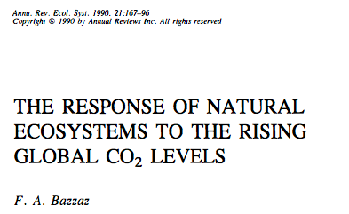
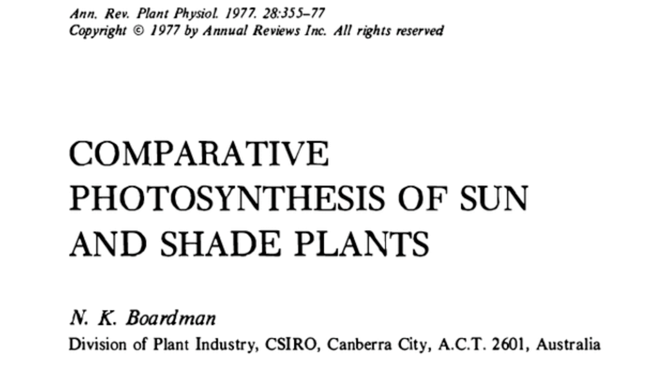
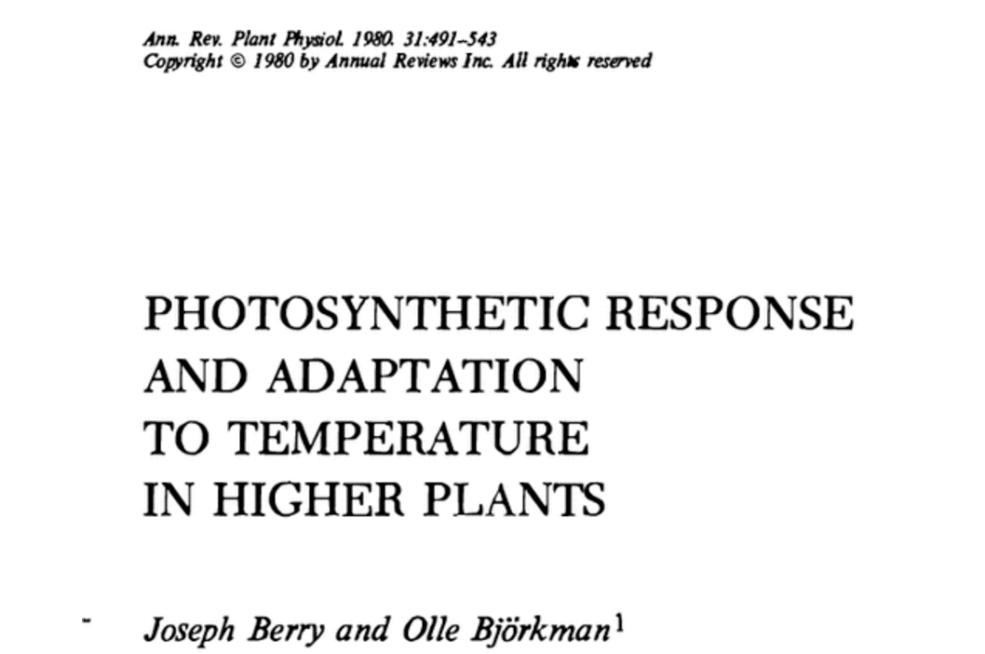
Acclimation is ubiquitous and well known…
nick.smith@ttu.edu; @nick_greg_smith
Temperature: Berry & Björkman (1980)
CO₂: Bazzaz (1990)
Light: Boardman (1977)

Slide 4
…and can impact carbon cycling and climate…
nick.smith@ttu.edu; @nick_greg_smith
Acclimation alters future temperature by >1°C
Smith et al. (2017) JAMES

Slide 5
…but the mechanisms underlying photosynthetic acclimation are not well known
nick.smith@ttu.edu; @nick_greg_smith

Slide 6
Solution: A testable, theoretical model!
nick.smith@ttu.edu; @nick_greg_smith

Slide 7
Least cost theory
nick.smith@ttu.edu; @nick_greg_smith
Maintain fastest rate of photosynthesis at the lowest cost (water and nutrient use)
Wright et al. (2003) American Naturalist

Slide 8
Least cost theory
nick.smith@ttu.edu; @nick_greg_smith
[INSERT MATHS HERE]

Slide 9
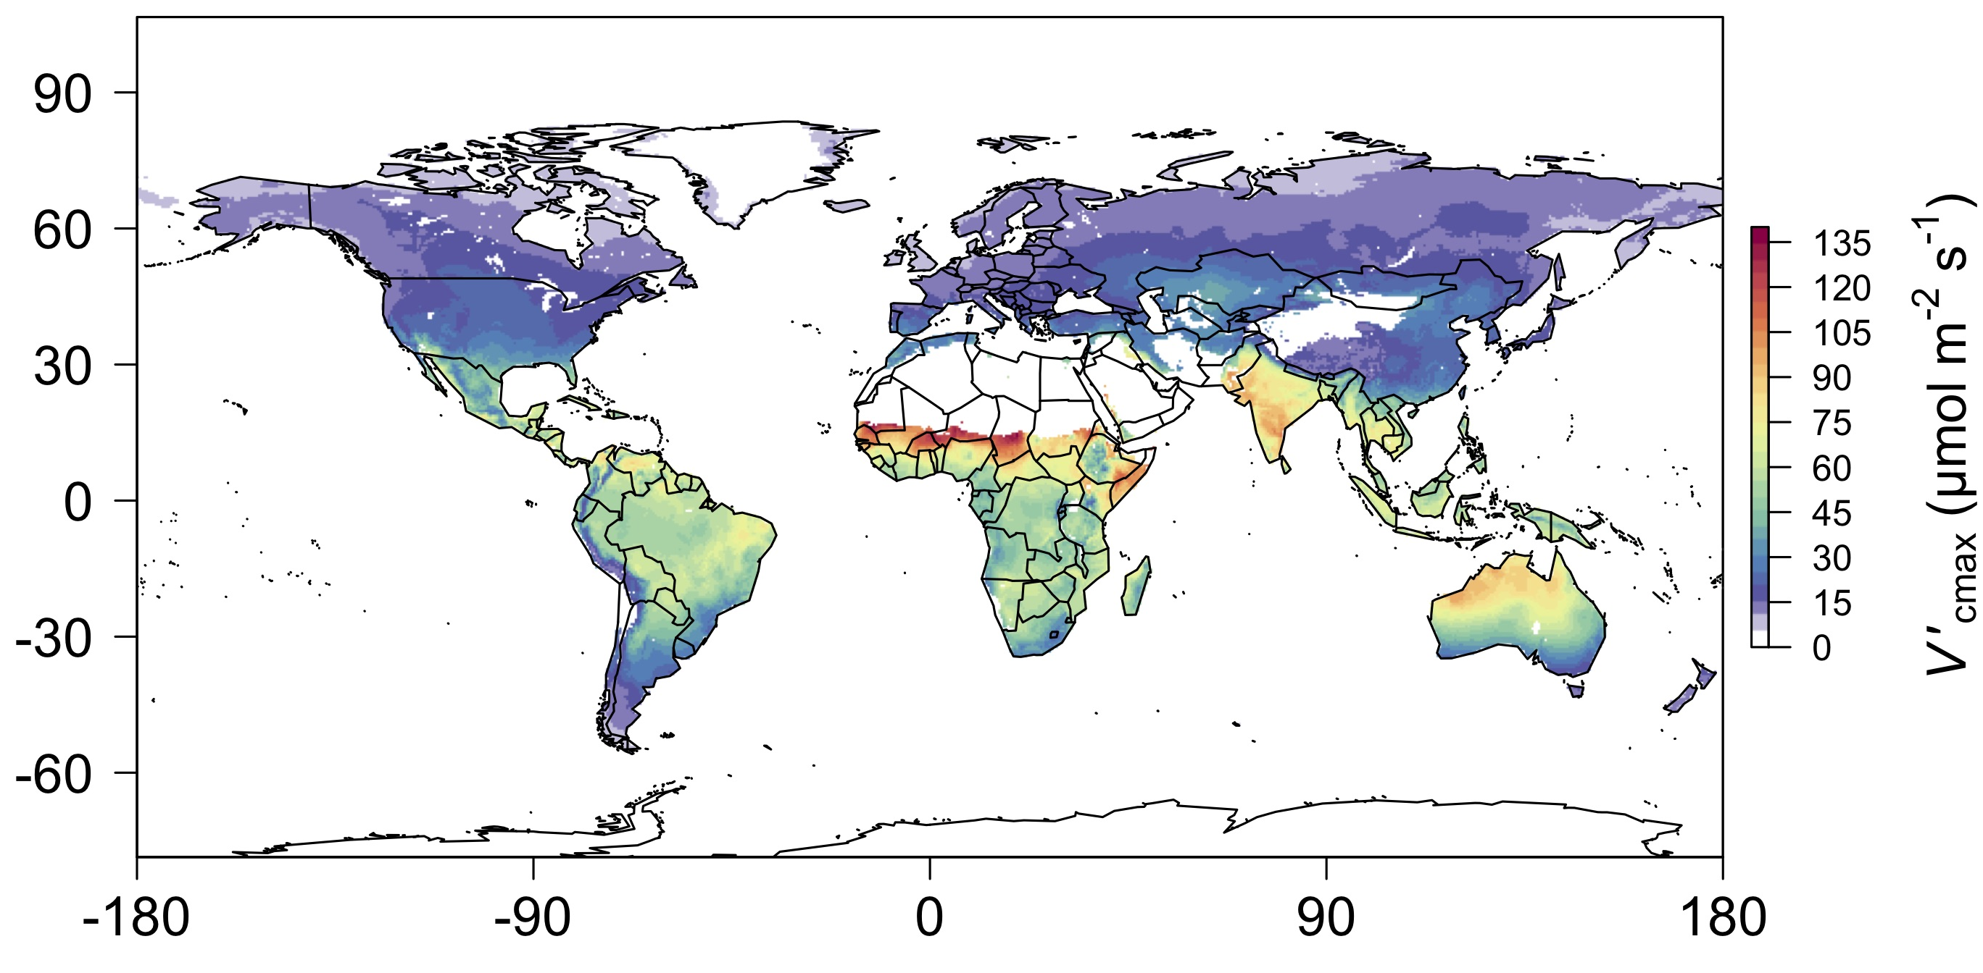
nick.smith@ttu.edu; @nick_greg_smith
We can predict optimal traits in different environments
Smith et al. (2019) Ecology Letters

Slide 10
We can use the theory as a null model to explore acclimation mechanisms
nick.smith@ttu.edu; @nick_greg_smith

Slide 11
Let’s tackle some big questions in plant ecophysiology!
nick.smith@ttu.edu; @nick_greg_smith

Slide 12
Question 1: Is photosynthesis optimized to the environment?
nick.smith@ttu.edu; @nick_greg_smith

Slide 13
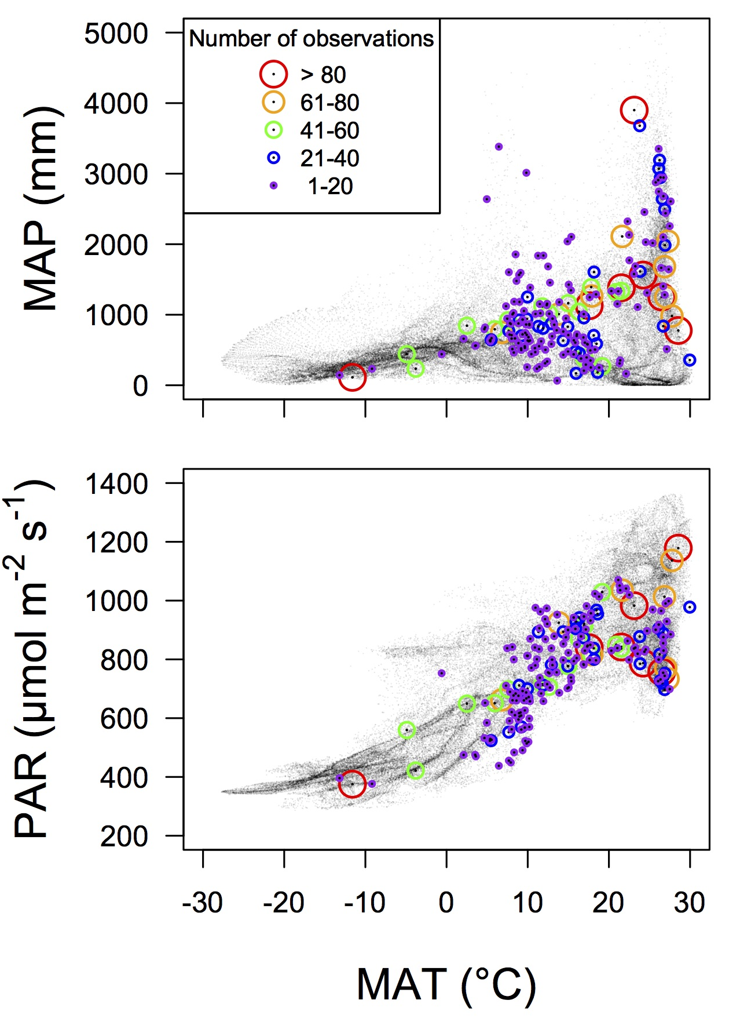
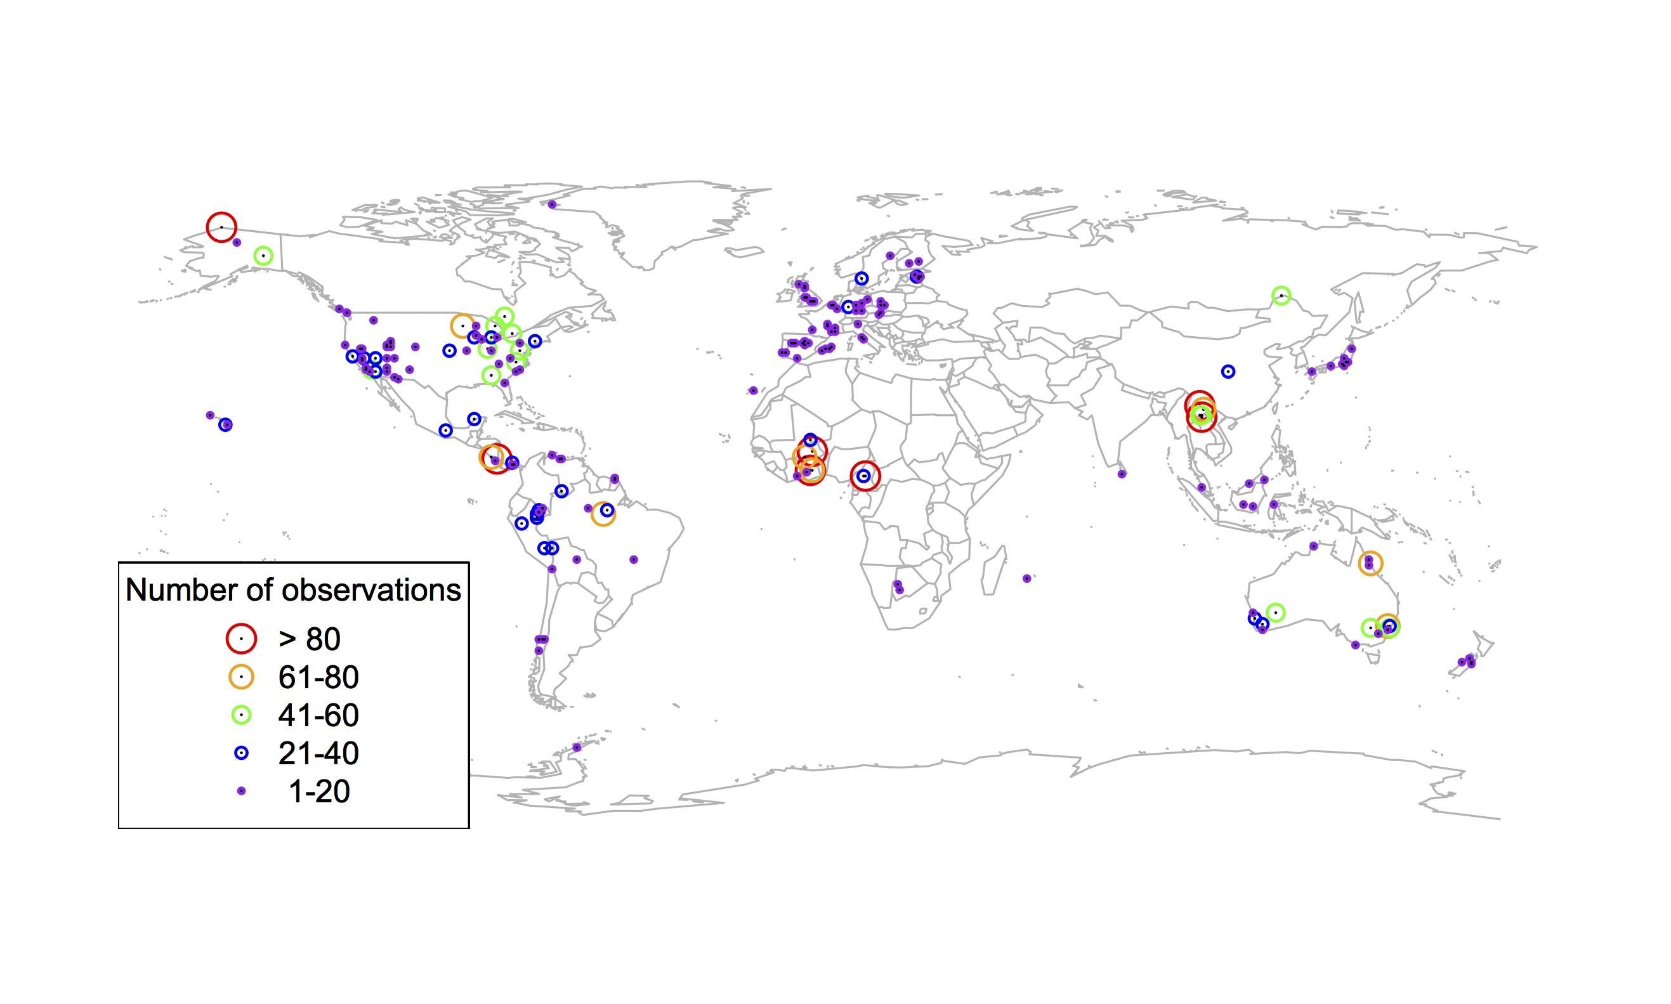
Global V_{cmax} dataset
nick.smith@ttu.edu; @nick_greg_smith
3,697 measurements
202 sites
> 600 genera
Smith et al. (2019) Ecology Letters

Slide 14
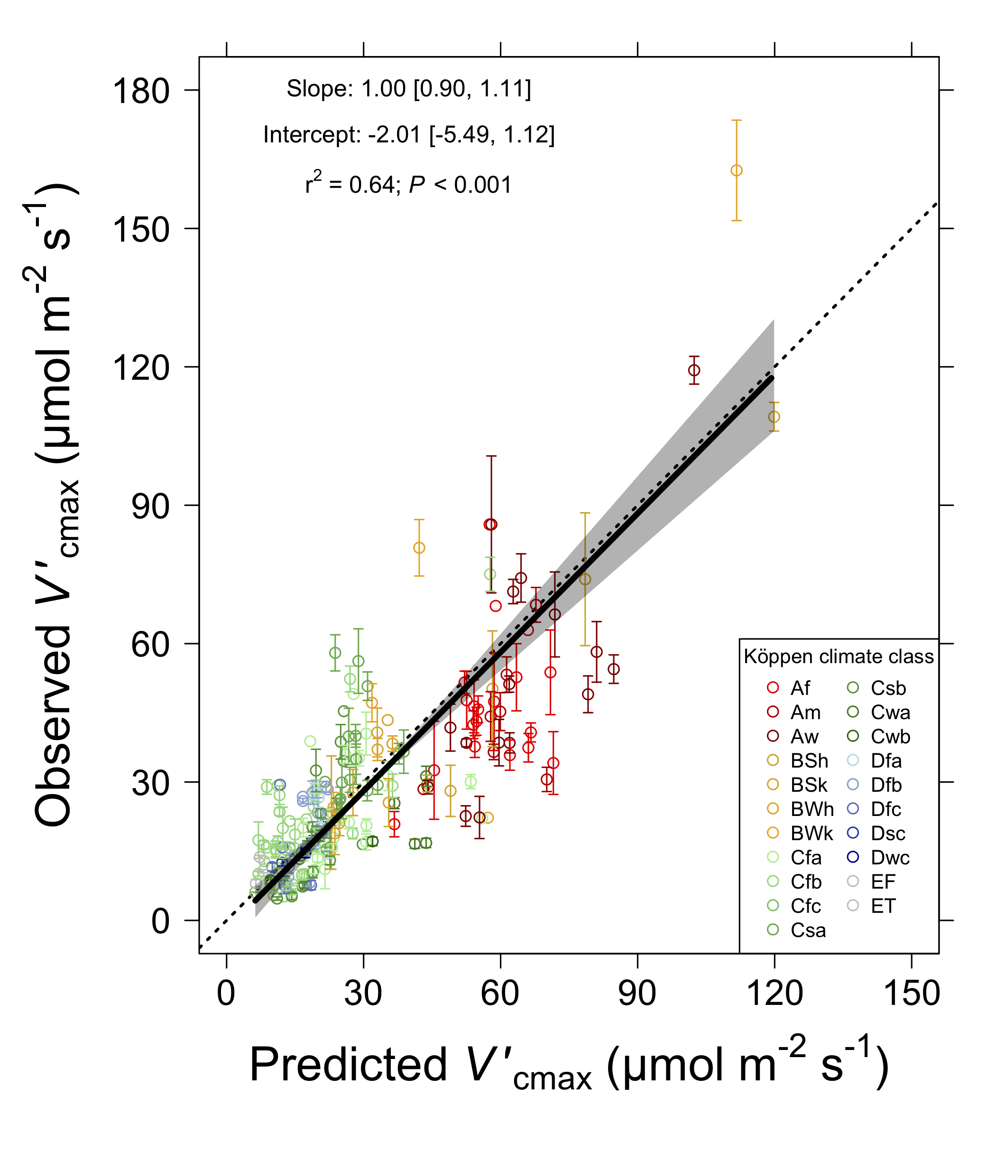
nick.smith@ttu.edu; @nick_greg_smith
Smith et al. (2019) Ecology Letters

Slide 15
Question 1: Is photosynthesis optimized to the environment? YES! Photosynthesis acclimates spatially as expected from optimization
nick.smith@ttu.edu; @nick_greg_smith

Slide 16

Question 2: Does photosynthesis respond to soil nutrients?
nick.smith@ttu.edu; @nick_greg_smith
Lizz Waring
TTU

Slide 17
From the least cost hypothesis…
nick.smith@ttu.edu; @nick_greg_smith
Added nutrients will not increase photosynthesis because light limitation will kick in

Slide 18
From the least cost hypothesis…
nick.smith@ttu.edu; @nick_greg_smith
Added nutrients will not increase photosynthesis because light limitation will kick in
Optimal response would be to increase leaf area

Slide 19
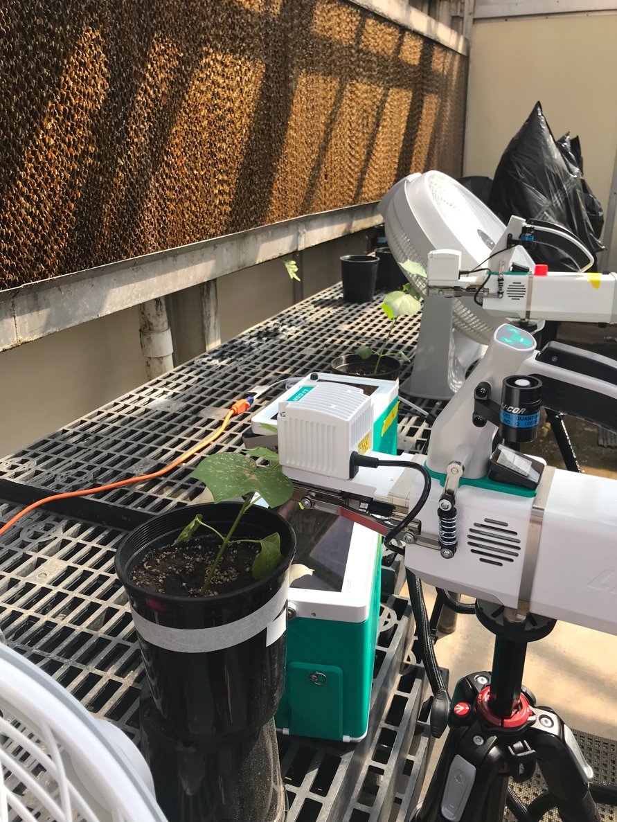
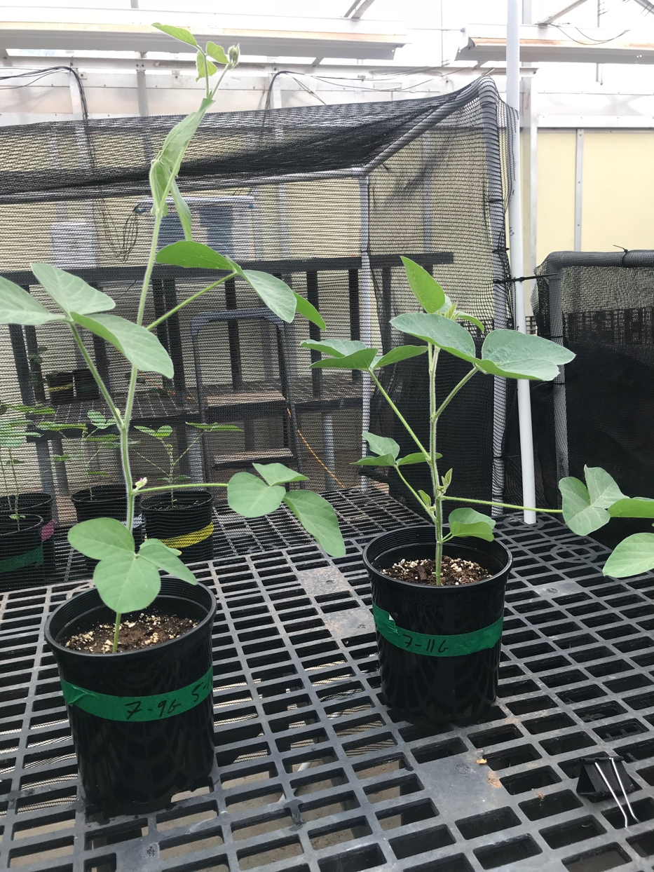
But let’s test it experimentally
nick.smith@ttu.edu; @nick_greg_smith

Slide 20
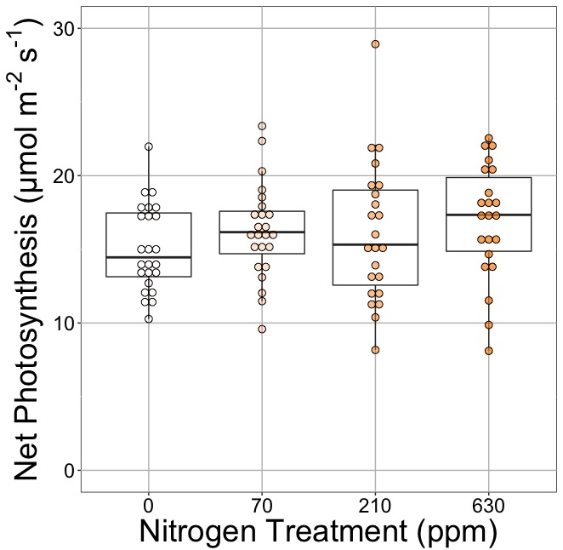
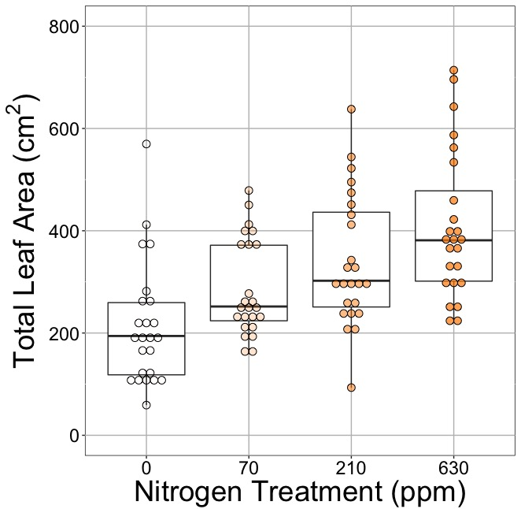
nick.smith@ttu.edu; @nick_greg_smith
Waring and Smith (in prep)

Slide 21
nick.smith@ttu.edu; @nick_greg_smith
No change (P = 0.42)
Waring and Smith (in prep)

Slide 22
Leaf area, but not photosynthesis increases with N addition
nick.smith@ttu.edu; @nick_greg_smith
No change (P = 0.42)
91% increase (P < 0.05)
Waring and Smith (in prep)

Slide 23
But do greenhouse experiments translate to the field?
nick.smith@ttu.edu; @nick_greg_smith

Slide 24
nick.smith@ttu.edu; @nick_greg_smith
Grassland soil nutrient addition network:
Leaf area index
Per-leaf-area nitrogen (photosynthetic proxy)

Slide 25
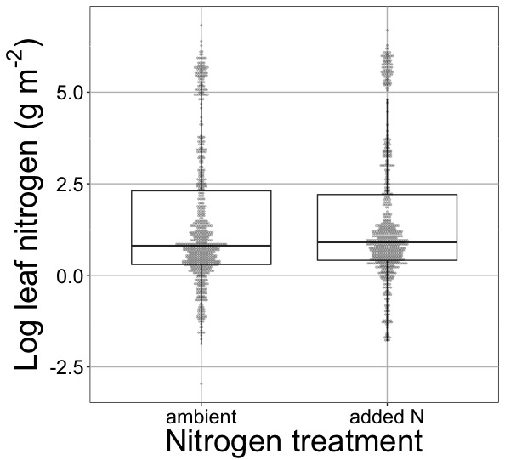
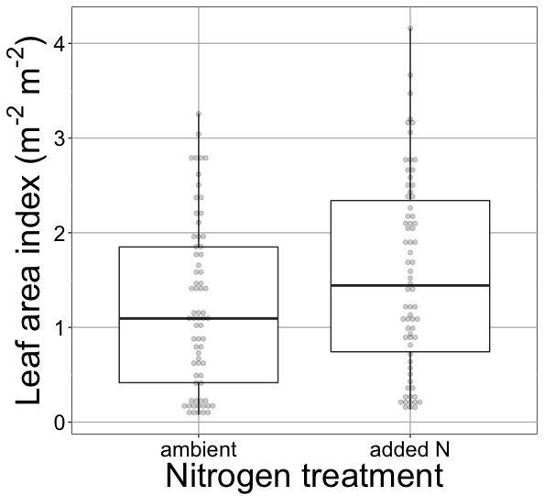
nick.smith@ttu.edu; @nick_greg_smith
Waring and Smith (in prep)

Slide 26
nick.smith@ttu.edu; @nick_greg_smith
No change (P > 0.05)
Waring and Smith (in prep)

Slide 27
Globally, N addition increases leaf area, not leaf N
nick.smith@ttu.edu; @nick_greg_smith
No change (P > 0.05)
41% increase (P < 0.05)
Waring and Smith (in prep)

Slide 28
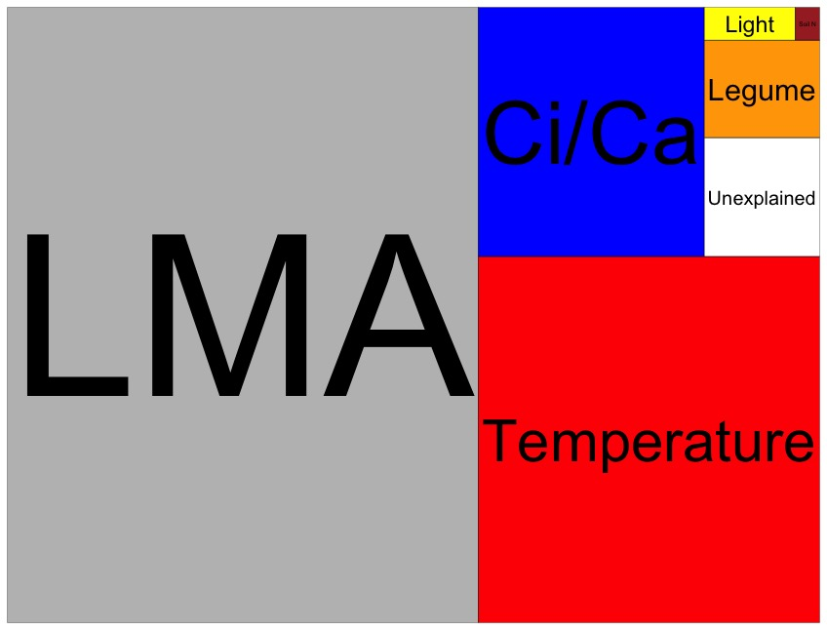
Globally, N addition has no impact on leaf N
nick.smith@ttu.edu; @nick_greg_smith
Each box is proportional to the variance in leaf N explained by each variable
Waring and Smith (in prep)

Slide 29
Question 2: Does photosynthesis respond to soil nutrients? No, plants respond to added nutrients by increasing leaf area, not photosynthesis
nick.smith@ttu.edu; @nick_greg_smith

Slide 30

Question 3: What does acclimation mean for future conditions?
nick.smith@ttu.edu; @nick_greg_smith

Slide 31
Photosynthetic traits change with future conditions in ways expected from optimization
nick.smith@ttu.edu; @nick_greg_smith
mean: -12%
mean: -15%
(P > 0.05)
Smith and Keenan (in prep)

Slide 32
Let’s run a model out into the future!
nick.smith@ttu.edu; @nick_greg_smith

Slide 33
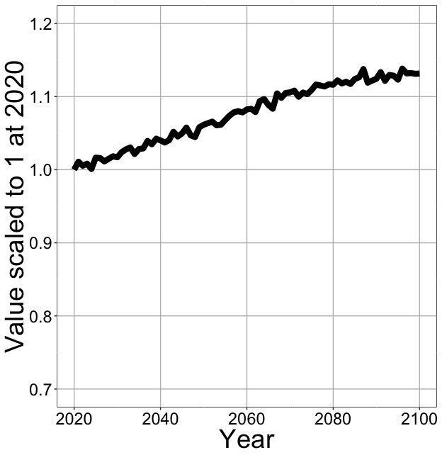
Photosynthesis increases in future
nick.smith@ttu.edu; @nick_greg_smith
Net Photosynthesis
Smith et al. (in prep)

Slide 34
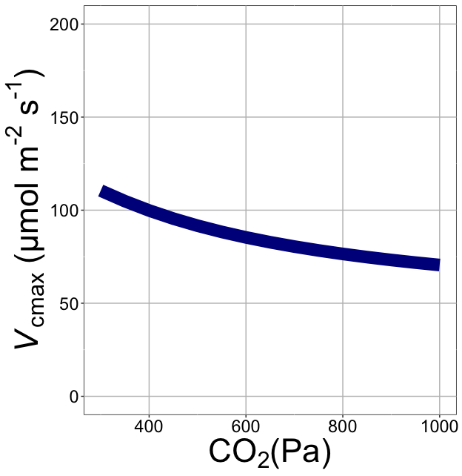
Downregulation under elevated CO₂ would reduce leaf nutrient demand!
nick.smith@ttu.edu; @nick_greg_smith
Smith et al. (2019)

Slide 35
Photosynthesis increases in future
nick.smith@ttu.edu; @nick_greg_smith
Net Photosynthesis
Smith et al. (in prep)

Slide 36
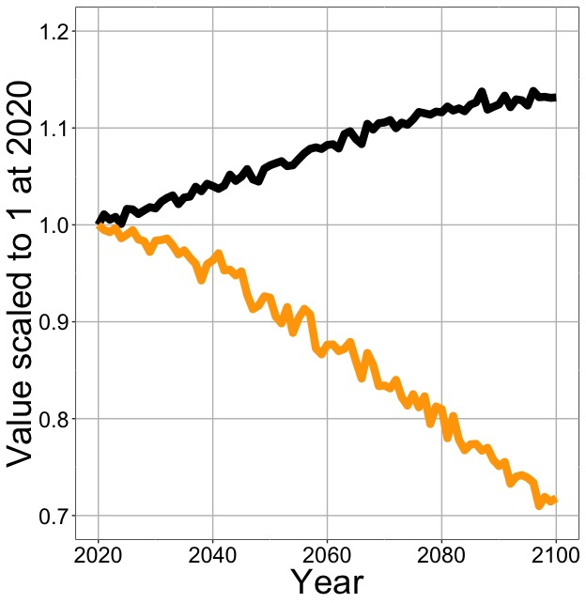
Photosynthesis increases in future (at lower nutrient use)
nick.smith@ttu.edu; @nick_greg_smith
Net Photosynthesis
Leaf Nitrogen
Smith et al. (in prep)

Slide 37
Need to rethink nutrient limitation in models
“No limitation” simulation
“Nutrient limitation” simulations
Weider et al. (2015)

Slide 38
Question 3: What does acclimation mean for future conditions? Photosynthesis will increase and per-leaf-area nutrient use will decrease
nick.smith@ttu.edu; @nick_greg_smith

Slide 39
Conclusions
nick.smith@ttu.edu; @nick_greg_smith

Slide 40
Conclusions
nick.smith@ttu.edu; @nick_greg_smith
Plants aren’t dumb!
Need to make sure our models allow for acclimation responses
Dumb plants

Slide 41
Conclusions
nick.smith@ttu.edu; @nick_greg_smith
Theory yields mechanistic insight about acclimation and associated feedbacks

Slide 42
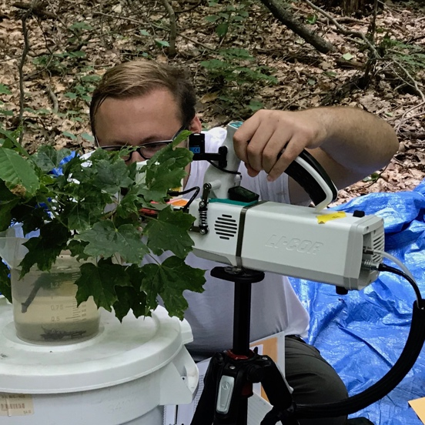
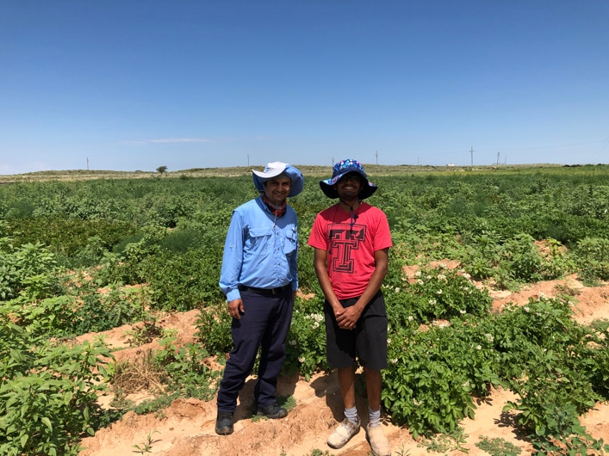
Conclusions
nick.smith@ttu.edu; @nick_greg_smith
Theory yields mechanistic insight about acclimation and associated feedbacks
We using it to study
C3/C4 competition
Plant invasion
Mycorrhizal symbioses
Agriculture
Herbarium specimens

Slide 43
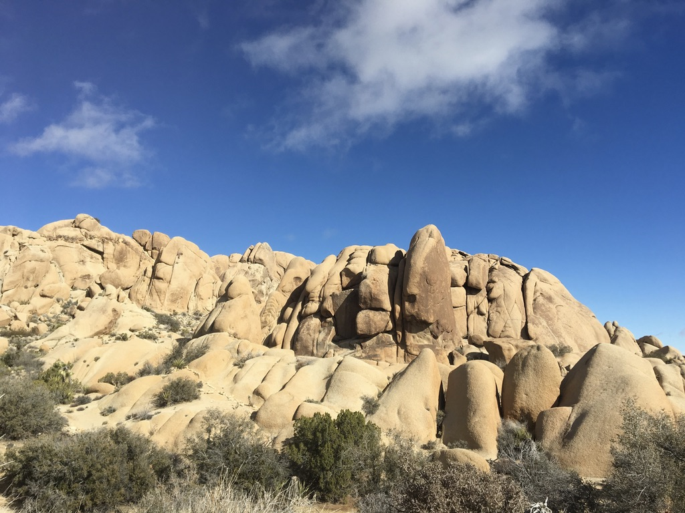
nick.smith@ttu.edu; @nick_greg_smith
Presentation available at:
www.github.com/SmithEcophysLab/agu_2019
Thanks!

